Slide 1
Applied Programming & Design Principles
S - 02
Ms. ALF. Sajeetha
Lecturer - IT

Slide 2
Binding of Attributes to Variable
Static - A binding is static if it first occurs before run time begins and remains unchanged throughout program execution.
Dynamic - If the binding first occurs during run time or can change in the course of program execution, it is called dynamic.

Slide 3
Stack and Heap Memory
Stack memory is a sort of memory allocation that the OS continuously manages and uses to store local variables in a LIFO order.
Heap memory is a type of dynamic memory allocation used for storing objects and data structures that require a longer lifespan than stack memory

Slide 4
Exception handling
Exception handling in Python allows a program to deal with unexpected errors or exceptions gracefully, without crashing. When an error occurs during the execution of a program, Python will raise an exception, and with exception handling, you can manage these errors and execute code accordingly

Slide 5
Elements/blocks
try block: The code that may raise an exception is written inside the try block.
except block: This block catches and handles the exception that occurs in the try block.
else block: Code inside the else block runs if no exception is raised in the try block.
finally block: Code inside the finally block will always run, whether an exception occurs or not. It is typically used for cleanup actions (like closing files or releasing resources).

Slide 6
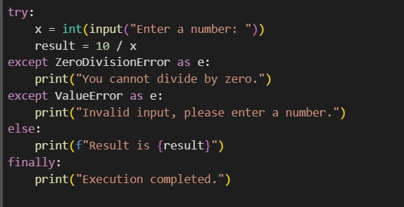
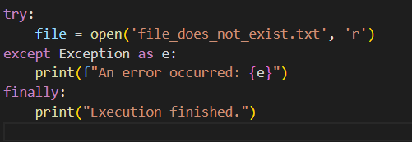
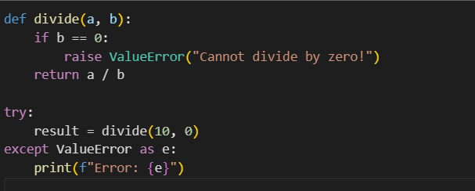

Slide 7
Exercise
Create a BankAccount class with the following attributes, account holder, balance, Write methods for deposit(amount) and withdraw(amount), If the withdrawal amount exceeds the balance, raise an InsufficientFundsError (create this custom exception), Handle the InsufficientFundsError when trying to withdraw more than the available balance, Implement exception handling for invalid deposit/withdrawal amounts (eg, non-numeric input)

Slide 8
Typing Module in python (for type hints)
The Python runtime does not enforce function and variable type annotations. They can be used by third party tools such as type checkers, IDEs, linters, etc.
int, float, str, bool are the basic types can be used for type hints, similar to regular Python types.

Slide 9
Typehint in Python
Type hints in Python provide a way to indicate the expected data types for function arguments, return values, and variables. They don't change the behavior of the code but are useful for documentation and static analysis tools like mypy or IDEs for better code hints and linting.
Notes:
Linting is the process of analyzing source code to detect potential errors, bugs, style violations, or suspicious constructs before runtime. Linting tools help developers maintain code quality and consistency by identifying issues like:
Syntax errors
Code that doesn't follow language best practices
Potential bugs or logical errors
Unused variables, imports, or code
Violations of code style (e.g., PEP 8 in Python)

Slide 10
mypy: Focuses primarily on static type checking.
pylint: Provides a more general-purpose linting and also checks for code quality.
flake8: Used for enforcing coding style (PEP8) but can be extended to check type hints with plugins.
Linters in Python that support type checking.
Notes:
int, str, float, bool: Basic data types.
List[type]: A list containing elements of a specific type.
Dict[key_type, value_type]: A dictionary with specific types for keys and values.
Tuple[type1, type2, ...]: A tuple containing specific types.
Optional[type]: A type that can either be the specified type or None.
Union[type1, type2, ...]: Accepts multiple possible types.
Any: Used when any type is acceptable.

Slide 11



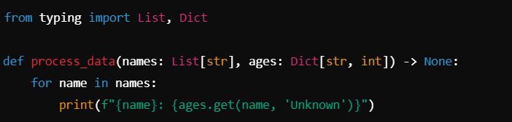

Slide 12
Python Decorators
A decorator is a function that takes another function as an argument, adds some kind of functionality, and returns a new function.
A Python decorator is a design pattern that allows you to modify or enhance the behavior of a function or method without changing its actual code. Decorators are often used to add functionality like logging, timing, access control, or memoization in a clean and reusable way

Slide 13
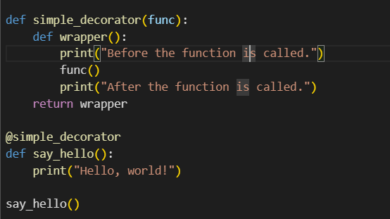

Slide 14
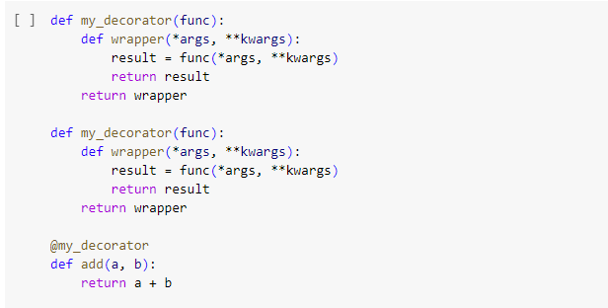

Slide 15
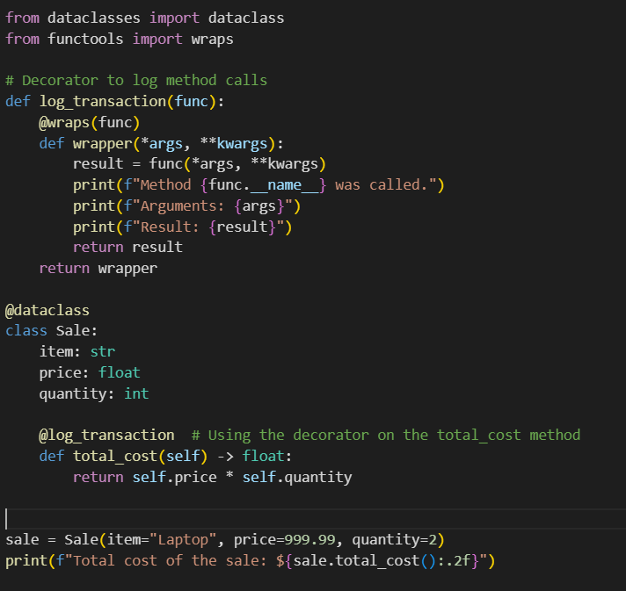
Notes:
The wraps function from the functools module is used as a decorator within decorators to preserve the original function’s metadata, such as its name, docstring, and other attributes, when a decorator is applied to it. Without wraps, the decorated function's metadata would be replaced by the wrapper function's metadata, making it difficult to access information about the original function

Slide 16
Exercise
Create a decorator that will decorate a sale_order function
Define a simple function that wraps the original sale_order function
Add additional functionality, such as logging, validation, or adding discounts
  decorator log_and_apply_discount logs information about the sale, including the discount
  decorated sale_order - sale_order function calculates the total cost based on the price, quantity, and discount
  The decorator is applied to the sale_order function using @log_and_apply_discount, so every time sale_order is called, the additional functionality (logging, discount application) is added
Error Handling
  checks if the price or quantity is negative and raises a ValueError if the input is invalid
Notes:
log_and_apply_discount Decorator:
The decorator log_and_apply_discount logs information about the sale, including the discount if applicable.
It wraps the sale_order function, processes the arguments, applies a discount, and then returns the final total cost.
Decorated sale_order Function:
The sale_order function calculates the total cost based on the price, quantity, and discount.
The decorator is applied to the sale_order function using @log_and_apply_discount, so every time sale_order is called, the additional functionality (logging, discount application) is added.
Error Handling:
The function checks if the price or quantity is negative and raises a ValueError if the input is invalid.
Usage:
The example shows a sale order for a customer named "Alice", where a 10% discount is applied to a product that costs $100 and a quantity of 3 is ordered.
The final output shows the total cost with logging information.

Slide 17
Python Data Classes
Python data classes are a feature introduced in Python 3.7 via the dataclasses module
They provide a convenient way to create classes that are primarily used to store data without having to write boilerplate code for methods like __init__, __repr__, __eq__, and __hash__
Data classes are essential for creating classes that mainly act as containers for attributes
Notes:
Boilerplate code is a piece of repetitive code that can be used over and over with little to no changes.

Slide 18
Features of Data Classes
Automatic __init__ Method: You don’t need to write an __init__ method; it’s automatically created based on the fields defined in the class.
Readable __repr__: Provides a readable string representation of the instance, making debugging easier.
Equality Comparison: The __eq__ method is automatically implemented to compare instances based on their field values.
Order Comparison: You can add order=True to the @dataclass decorator to automatically generate ordering methods (__lt__, __le__, __gt__, __ge__).
Immutability: Adding frozen=True to the @dataclass decorator makes the instances immutable (like namedtuples).
Customizability: You can still define your own methods and provide default values and additional metadata using the field() function, just like with normal class attributes.

Slide 19
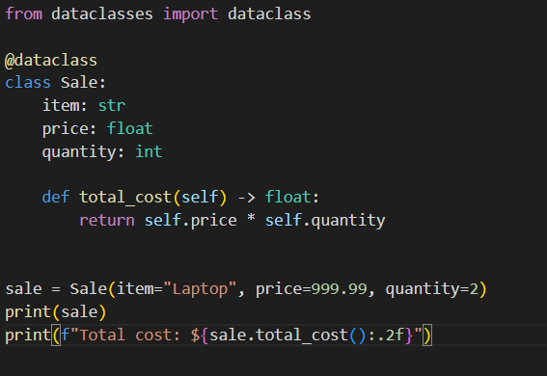

Slide 20
Exercise
Create data classes to analyze best-selling products based on sales data. This exercise should involve defining classes for Product, Sale, and SalesAnalysis to help identify the top-selling products in a supermarket.
Provide the path to your current tentative Sales Data, which is including transaction_id, product_id, quantity, sale_date etc.

